Slide 1
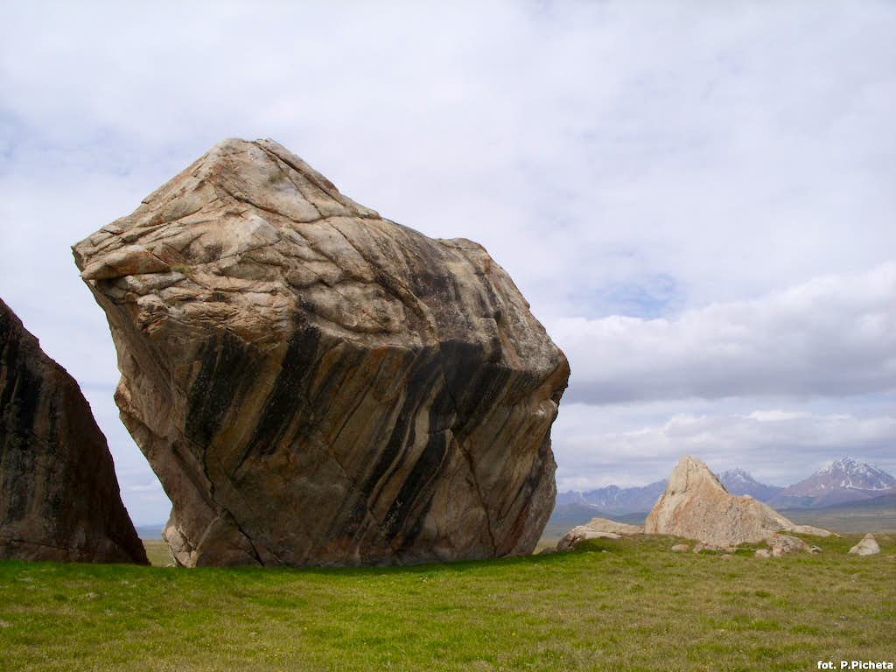
Jesus is
Consistent

Slide 2
Hebrews 13:6 - 8
⁶ So we say with confidence,
“The Lord is my helper; I will not be afraid.
What can mere mortals do to me?”^{[b]}
⁷ Remember your leaders, who spoke the word of God to you. Consider the outcome of their way of life and imitate their faith. ⁸ Jesus Christ is the same yesterday and today and forever.

Slide 3
The Jesus of Yesterday

Slide 4
The Joe of Yesterday

Slide 5
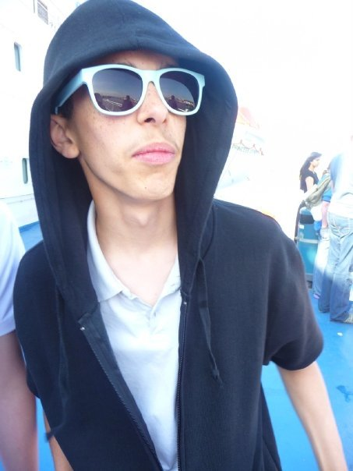

Slide 6
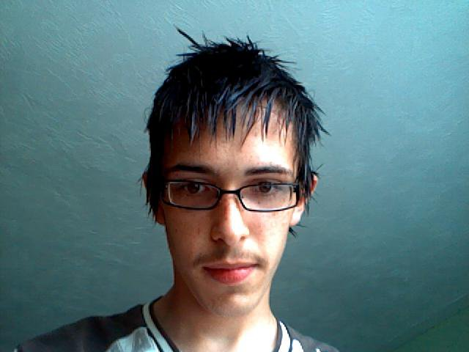

Slide 7
Do you compare yourself to the person of yesterday?

Slide 8
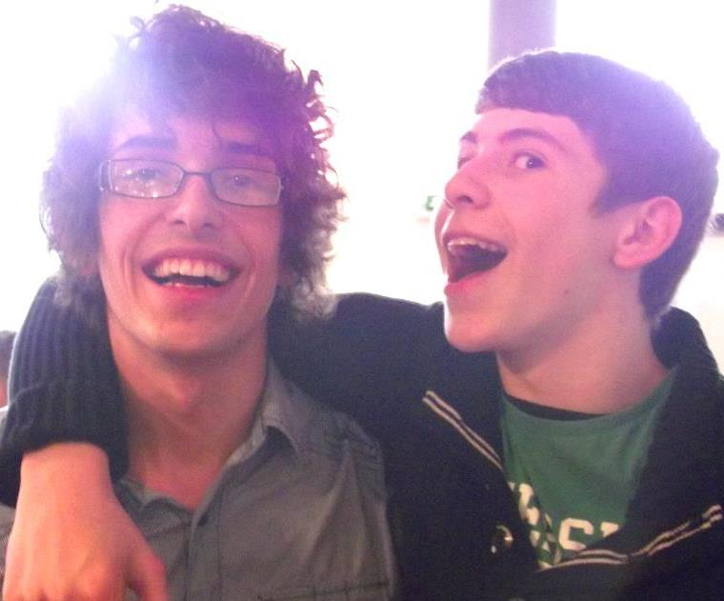

Slide 9
The Jesus of Yesterday

Slide 10
Includer
Overthrows the devil
Has power over nature
Loves
Teaches
Restores
Preforms miracles
Way Maker
Heals
Provides
Jesus
Welcomes unconditionally
Resurrects
Creates
Challenges
Befriends
Redeems
Saves
Challenges Theology
Sends out/Commissions
Sets people free

Slide 11
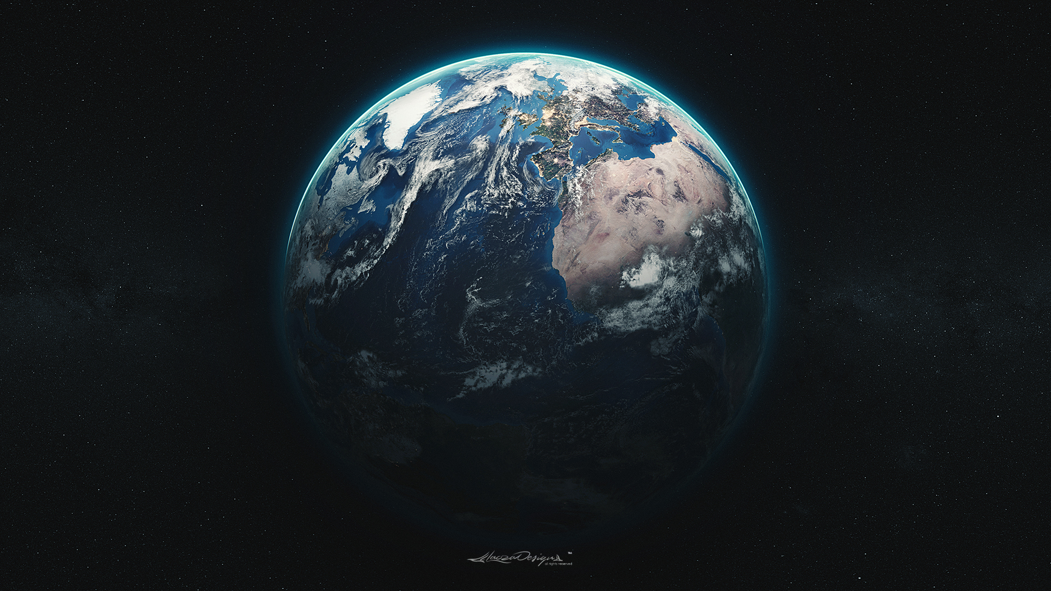
In the beginning…

Slide 12
Genesis 1:3
And God said, “Let there be light,” and there was light.

Slide 13
John 1:1-3, 14
1 In the beginning was the Word, and the Word was with God, and the Word was God. ² He was with God in the beginning. ³ Through him all things were made; without him nothing was made that has been made.
¹⁴ The Word became flesh and made his dwelling among us. We have seen his glory, the glory of the one and only Son, who came from the Father, full of grace and truth.

Slide 14
Jesus has existed throughout history, from the very start. He has always been working to create a place in which we can survive, thrive and flourish into all that God has for us.

Slide 15
The Jesus of Yesterday

Slide 16
The Jesus of Today

Slide 17
Colossians 1:15-17
¹⁵ The Son is the image of the invisible God, the firstborn over all creation. ¹⁶ For in him all things were created: things in heaven and on earth, visible and invisible, whether thrones or powers or rulers or authorities; all things have been created through him and for him. ¹⁷ He is before all things, and in him all things hold together.

Slide 18
Hebrews 13:8
⁸ Jesus Christ is the same yesterday and today and forever.

Slide 19
Jesus is
Consistent

Slide 20
Includer
Overthrows the devil
Has power over nature
Loves
Teaches
Restores
Preforms miracles
Way Maker
Heals
Provides
Jesus
Welcomes unconditionally
Resurrects
Creates
Challenges
Befriends
Redeems
Saves
Challenges Theology and Religious leaders
Sends out/Commissions
Sets people free

Slide 21
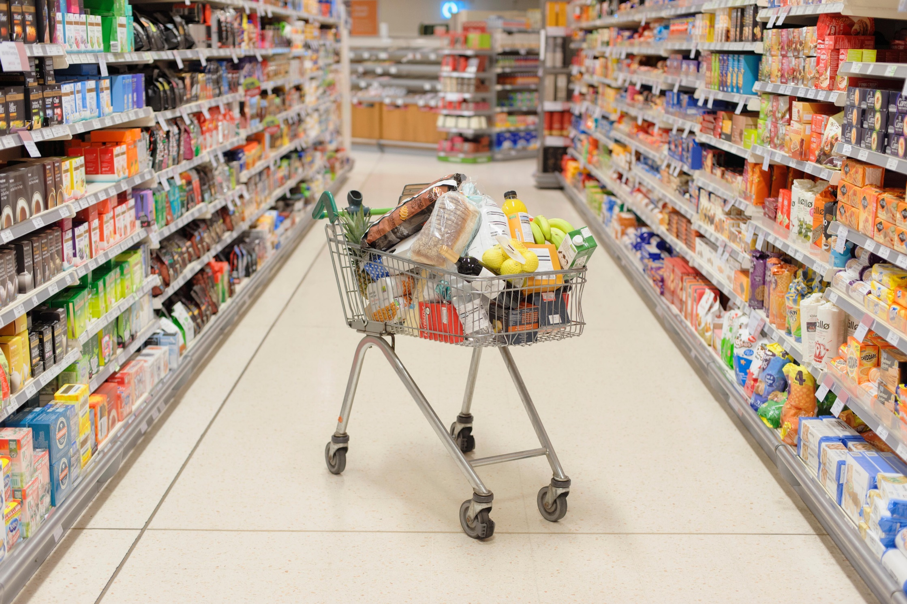

Slide 22
The Jesus of Today

Slide 23
The Jesus of Forever

Slide 24
Includer
Overthrows the devil
Has power over nature
Loves
Teaches
Restores
Preforms miracles
Way Maker
Heals
Provides
Jesus
Welcomes unconditionally
Resurrects
Creates
Challenges
Befriends
Redeems
Saves
Challenges Theology and Religious leaders
Sends out/Commissions
Sets people free

Slide 25
Hebrews 13:6 - 8
⁶ So we say with confidence,
“The Lord is my helper; I will not be afraid.
What can mere mortals do to me?”^{[b]}
⁷ Remember your leaders, who spoke the word of God to you. Consider the outcome of their way of life and imitate their faith. ⁸ Jesus Christ is the same yesterday and today and forever.

Slide 26


Slide 27
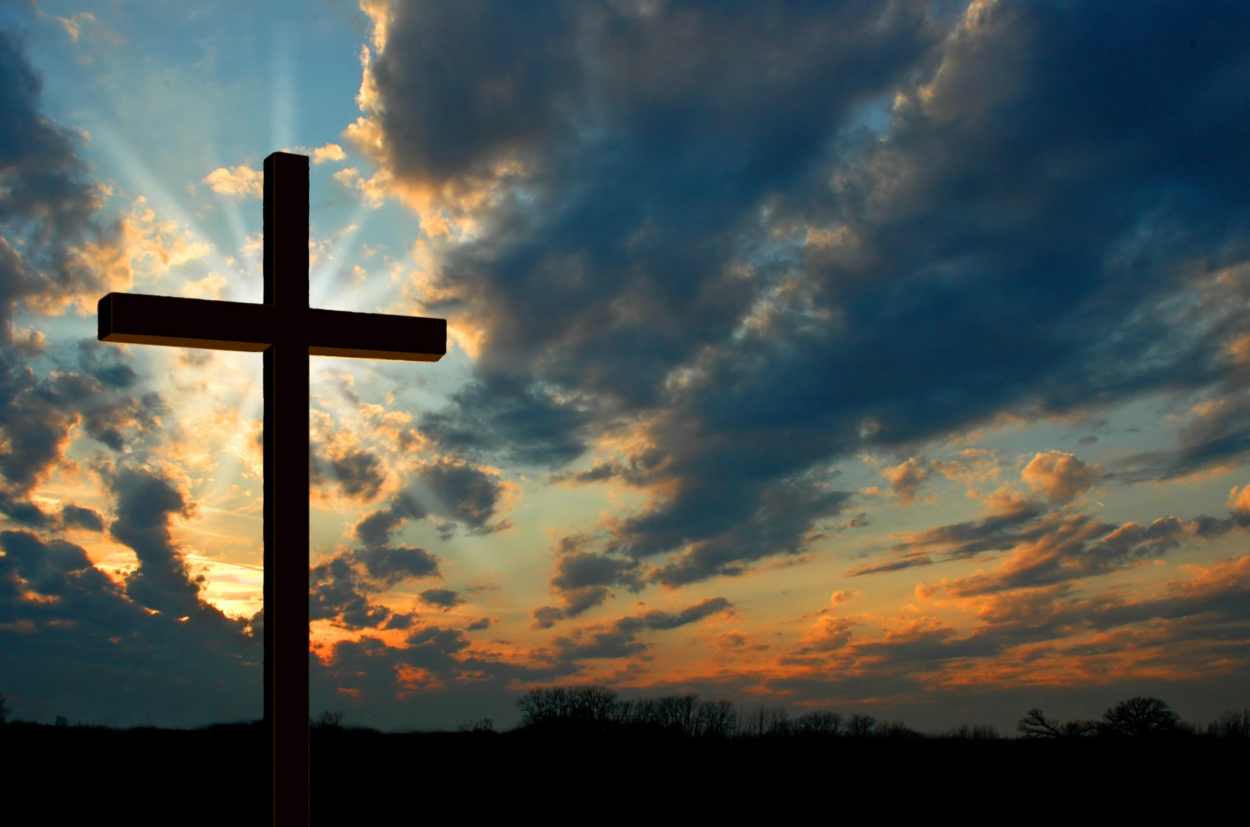

Slide 28
Jesus uses us to bring about his kingdom. How much will you allow Him to use you?

Slide 29
The Jesus of Forever

Slide 30
Jesus is
Consistent

